Slide 1

Loan Approval Analysis
Presented by – Rakshan Channe

Slide 2

Agenda
Introduction
Problem Statement
Data Overview
Hypothesis
Analysis Overview
Excel Analysis
SQL
Python (Logistic Regression)
Trends from the Data
Insights from the Analysis
Power BI Dashboard
Recommendations
Conclusion

Slide 3

Introduction
I have conducted a comprehensive analysis of the provided loan dataset, employing analytical tools such as Excel, Python, and SQL. This rigorous examination aimed to extract crucial insights that could inform and guide decision-making within the Loan Approval Committee. In addition to the analytical aspect, I have meticulously crafted an aesthetically pleasing dashboard using Power BI. This visual representation not only enhances the accessibility of complex data but also serves as a strategic tool for presenting key findings. Today, I am honored to present the synthesized outcomes of this thorough analysis.

Slide 4

Problem Statement
XYZ company deals in all home loans. They have a presence across all urban, semi-urban and rural areas. Customers first apply for a home loan after that company validates the customer’s eligibility for a loan. The company wants to automate the loan eligibility process (real-time) based on customer detail provided while filling out the online application form. These details are Gender, Marital Status, Education, Number of Dependents, Income, Loan Amount, Credit History, and others. To automate this process, they have given a problem to identify the customer segments, that are eligible for loan amounts so that they can specifically target these customers.

Slide 5
Data Overview
Total Records: 381
Key Variables:
Loan_ID: Unique identifier for each loan application.
Gender: Gender of the applicant (Male/Female).
Married: Marital status of the applicant (Yes/No).
Dependents: Number of dependents.
Education: Applicant's education level (Graduate/Not Graduate).
Self_Employed: Whether the applicant is self-employed (Yes/No).
ApplicantIncome: Income of the applicant.
CoapplicantIncome: Income of the co-applicant.
LoanAmount: The amount of the loan requested.
Loan_Amount_Term: Term of the loan in months.
Credit_History: Credit history of the applicant (1: Good, 0: Not Good).
Property_Area: Area where the property is located (Urban/Semiurban/Rural).
Loan_Status: Approval status of the loan (Y: Approved, N: Not Approved).

Slide 6

Hypothesis
Below are some of the factors which I think can affect the Loan Approval (dependent variable for this loan prediction problem:
Income: Applicants with high income should have more chances of getting approval.
Previous credit history: Applicants who have paid their historical debts have more chances of getting approval.
Loan amount: Less the amount higher the chances of getting approval.
Loan term: Less the time period has higher chances of approval.
EMI: Lesser the amount to be paid monthly, the higher the chances of getting approval.

Slide 7
Analysis Overview
The analysis unfolded through a series of strategic steps, each contributing to a deeper understanding of the loan dataset.
In Excel, I started by exploring the data, using pivot tables and charts to get a first look at trends and patterns.
Moving to SQL, my focus shifted to data preparation. I worked on cleaning and organizing the dataset, ensuring that it was in top-notch condition for subsequent analyses. SQL played a vital role in shaping the groundwork for more advanced investigations.
With the help of Python, particularly within Jupyter Notebook, I delved into machine learning with logistic regression. This step aimed to predict loan approval outcomes, providing a quantitative perspective on the data.
The final piece of the puzzle was Power BI, where I crafted an interactive dashboard. This tool allowed me to showcase the data in a visually compelling manner, offering an intuitive way to explore key metrics and trends.
This comprehensive approach, involving Excel, SQL, Python, and Power BI, ensures a well-rounded analysis, providing valuable insights for strategic decision-making.

Slide 8
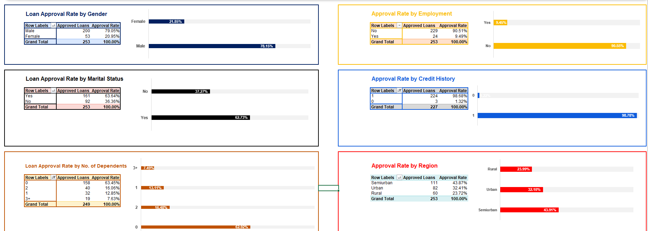
Excel Analysis Overview
The provided dataset was cleaned and prepared for analysis.
With help of pivot tables and charts various analysis is done on the data to identify trends and generate insights.
Calculated various loan approval rates that depends on various demographics and financial metrics of the data.

Slide 9
Findings
By doing comprehensive analysis in Excel it is evident that the loan approval is dependent on the following aspects:
Gender of the Applicant
Applicant and Co-applicant Income
Applicant Credit History
Loan Amount requested by the Applicant

Slide 10
Trend Analysis by Gender
One of the primary revelations lies in the distinct contrast observed in approval rates based on gender.
Male applicants demonstrated an approval rate of 79%, while female applicants exhibited a notably different rate of 21%.
Male applicants exhibit a higher likelihood of loan approval in comparison to their female counterparts.
Significantly larger portions of loan amounts are requested by male applicants as opposed to female applicants.
The dataset reflects a higher number of male applicants in comparison to female applicants.

Slide 11
71.27%

Slide 12
Effects of Demographics on Loan Approval
One of the primary revelations lies in the distinct contrast observed in approval rates based on gender.
Male applicants demonstrated an approval rate of 79%, while female applicants exhibited a notably different rate of 21%.

Slide 13
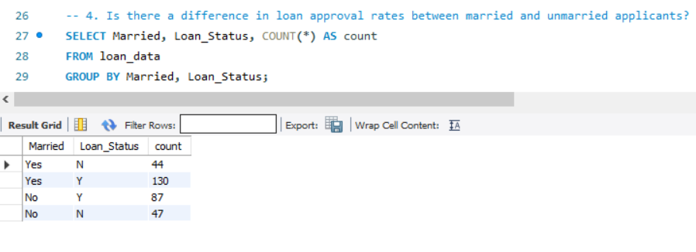
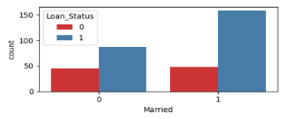
Trend Analysis by Marital Status
Marital status appears to influence loan approval, with married individuals having a more favorable trend.

Slide 14
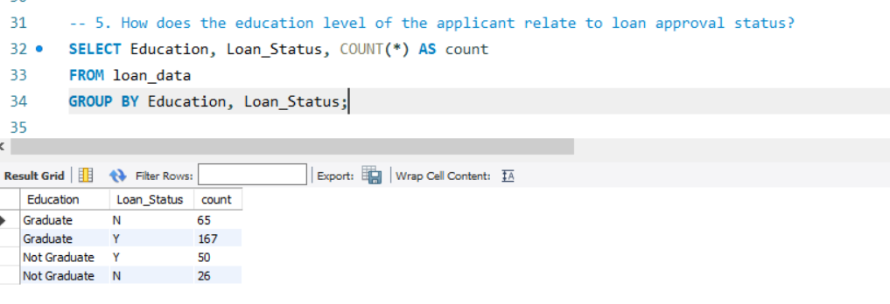
Trend Analysis by Education
Graduates tend to have a slightly higher approval rate compared to non-graduates.
Graduates generally exhibit higher incomes, contributing to their increased likelihood of loan approval.
Both graduate and non-graduate applicants benefit significantly from a positive credit history.
While education is a factor, the credit history appears to be a more influential determinant for loan approval.

Slide 15
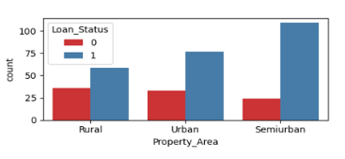
Trend Analysis by Region
Higher loan approval rates observed in semi-urban areas, compared to urban and rural areas.
Across all regions, the common thread is the significance of a good credit history in influencing loan approval.
While urban areas showcase higher approval rates, the impact of credit history remains consistent, emphasizing its importance.

Slide 16
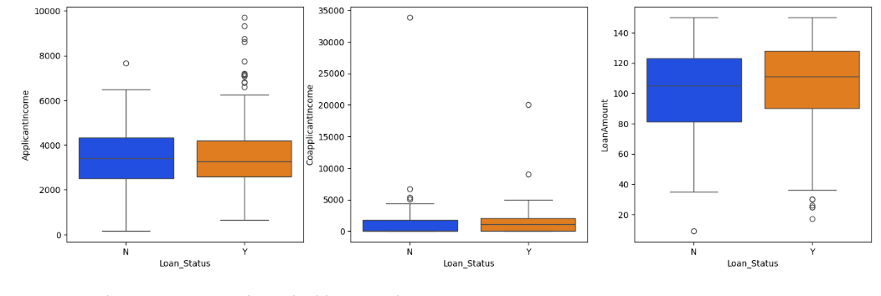
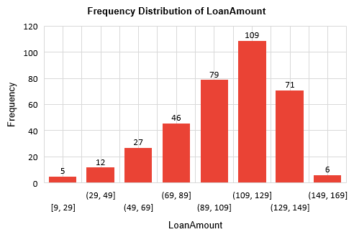
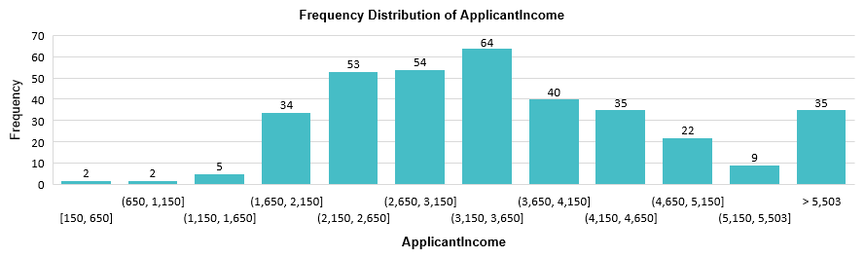
Trend Analysis by Applicant & Co-applicant Income
Applicant & Co-applicant Income has a direct correlation to loan approval with average being $3,599 and $1,278 respectively.

Slide 17
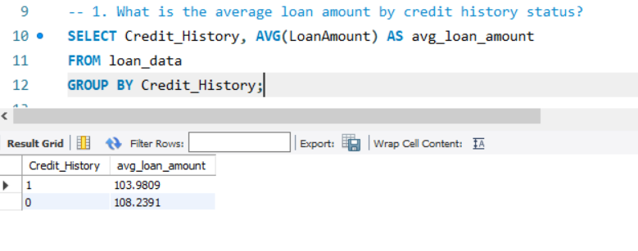
Trend Analysis by LoanAmount
Average Loan Amount requested is $105.
Applicant with lesser loan amount requested has higher chance of approval.
Gradual decrease in approval rates with increasing loan amounts.

Slide 18
Trend Analysis by Credit History
Higher approval rates observed for applicants with a positive credit history.
The trend remains robust across various demographics, including gender, education, and region.
Higher approval rates observed for applicants with a positive credit history.
Findings validate the importance of considering credit history in the loan approval process.

Slide 19
Insights from Analysis
Gender Impact:
Male applicants demonstrate a higher likelihood of loan approval compared to female applicants.
Income Influence:
Applicants with higher income levels exhibit a greater chance of loan approval.
Credit History Significance:
A positive credit history significantly increases the likelihood of loan approval.
Loan Amount Request:
Lower loan amount requests correlate with a higher chance of loan approval.
From comprehensive analysis of the data it is evident that the loan approval is dependent on the following aspects:
Gender of the Applicant
Applicant and Co-applicant Income
Applicant Credit History
Loan Amount requested by the Applicant

Slide 20
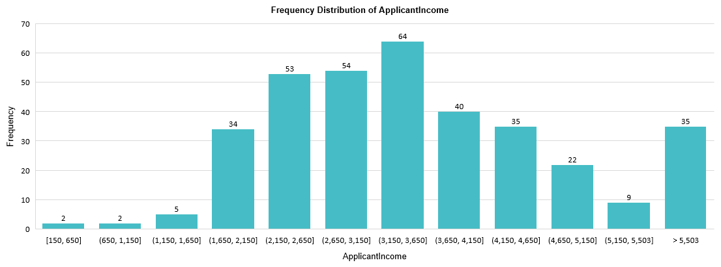
Effects of Financial Background on Loan Approval
Applicants with higher income has higher chances of loan approval along with their co-applicant income.
Average Applicant Income was $3,599 and the average loan amount asked was $105.

Slide 21

Trends and Insights from Excel Analysis
Male with higher applicant income and good credit history has higher chance of getting loan approval compared to Female.
Applicants with fewer dependents tend to have a slightly higher approval rate
Married applicants, particularly males, show a higher probability of loan approval
Higher applicant incomes correlate positively with increased approval rates

Slide 22
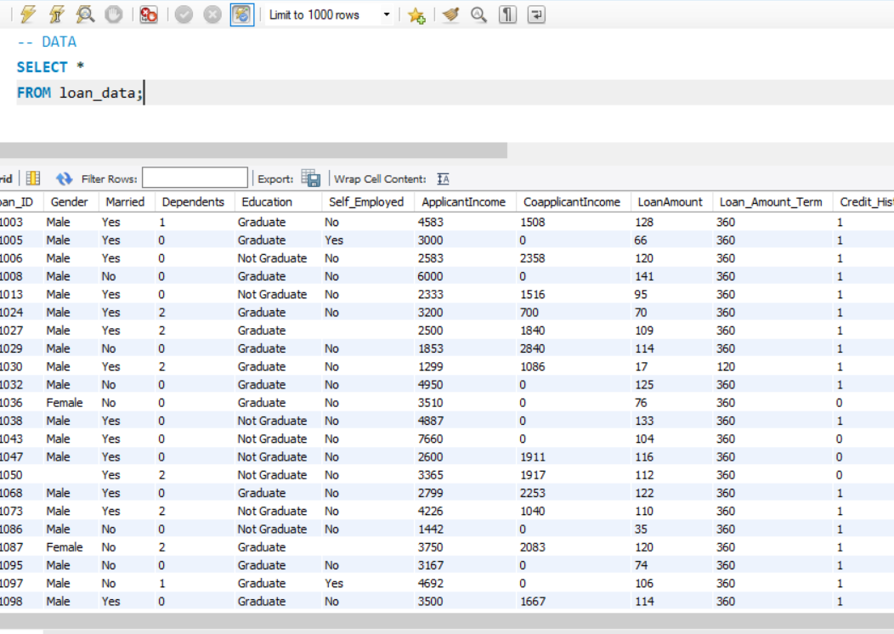
SQL Overview
Building upon the insights gained from Excel, SQL was employed to conduct a more in-depth Exploratory Data Analysis (EDA) and to answer more complex questions through SQL queries.
The dataset was imported to MySQL and the comprehensive EDA was performed to identify more trends and to generate more insights from the dataset.

Slide 23
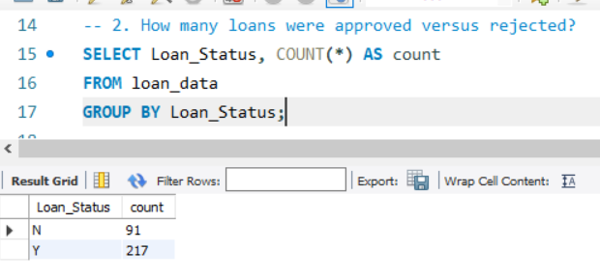
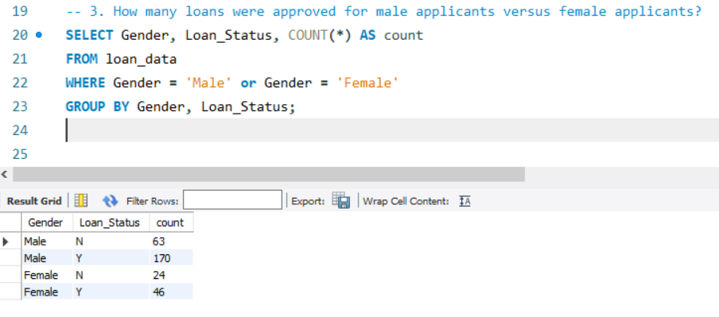
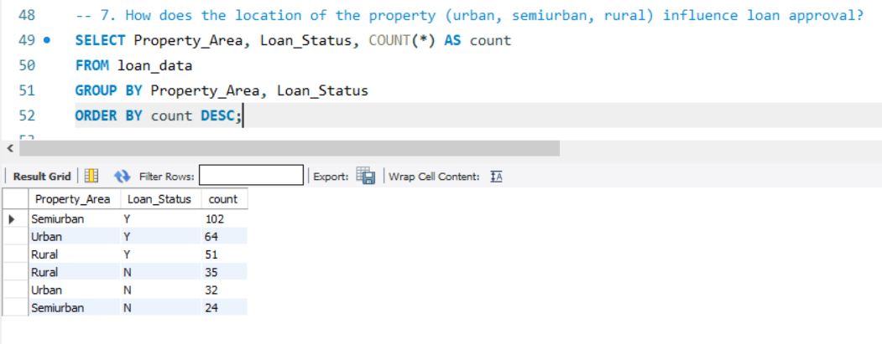
SQL Queries for Deeper Insights

Slide 24

Python Analysis Overview
In Jupyter notebook developed a python script with the help of Pandas, NumPy, Matplotlib, Seaborn, Scikit-learn machine learning to predict loan approval status based on the dataset.
Performed Data Cleaning, EDA and Logistic Regression on the dataset.

Slide 25
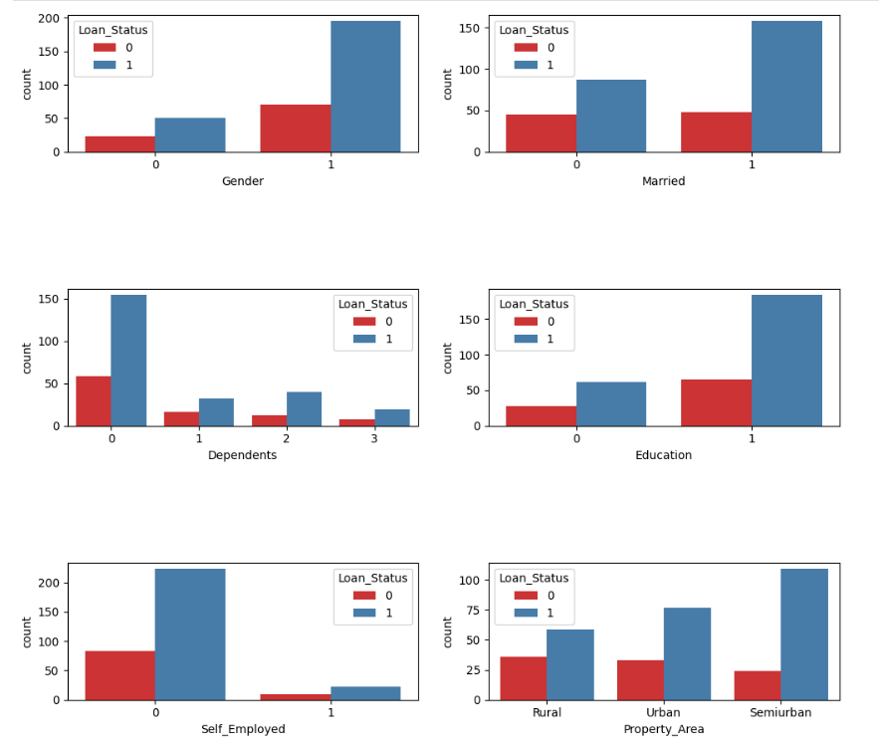
Analyzing Data in Python

Slide 26
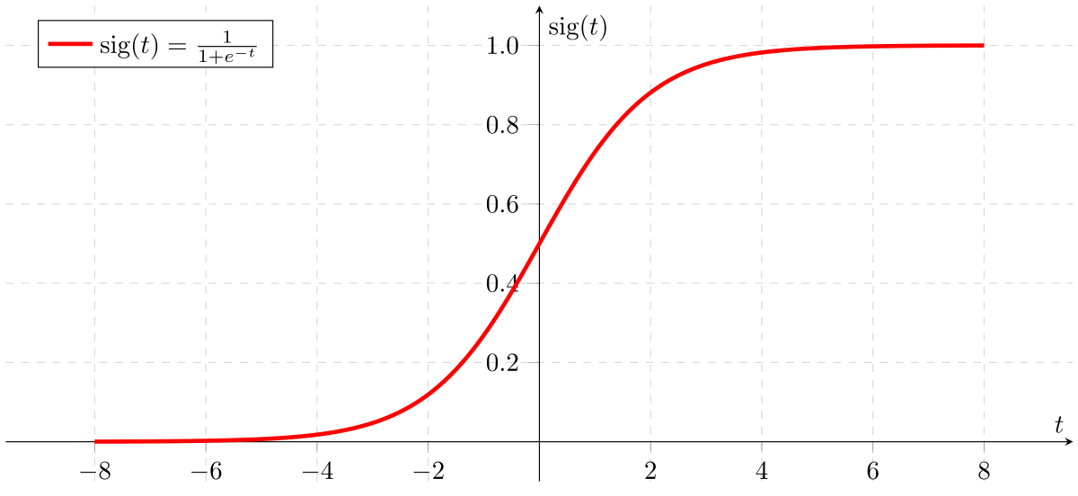
Logistic Regression in Python

Slide 27

Insights from Logistic Regression Model
The Loan Status is heavily dependent on the Credit History for Predictions.
Male are more likely to approval for loan than Female.
The Logistic Regression Algorithm gives us the Accuracy of 86%.

Slide 28
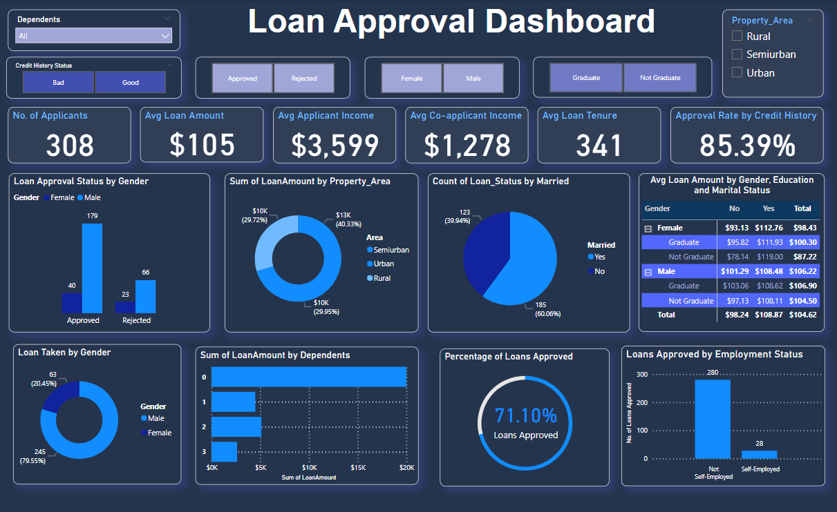
Data Visualization in Power BI

Slide 29
Power BI Dashboard
Findings and key insights derived from the extensive analysis have been seamlessly translated into visualizations using Power BI.
The dashboard is designed to be highly interactive, allowing users to dynamically explore various facets of the data.
This holistic approach empowers decision-makers to gain actionable insights, fostering a deeper understanding of the dataset's intricacies.

Slide 30

Ideal Candidate for Loan Approval
Based on the analysis of the given dataset, an ideal candidate who has higher chance of loan approval compared to other applicants posses the following attributes:
Gender: Male
Married Status: Married
Dependents: No dependents
Education: Graduate
Self_Employed: No
ApplicantIncome: Income greater than $3,264
CoapplicantIncome: Income greater than $1,887
LoanAmount: $105 amount requested
Loan_Amount_Term: Term of the loan is 360 months.
Credit_History: Good Credit history
Property_Area: Semi-urban

Slide 31
Recommendation to Loan Approval Committee
Strengthen the evaluation process for Credit History, potentially assigning different weightage based on the strength of credit.
Implement dynamic income brackets that consider both Applicant and Co-applicant Incomes, providing a more realistic assessment of repayment capacity.
Reassess Loan Amount criteria to reflect optimal ranges for approval, minimizing risk while catering to diverse financial needs.

Slide 32
CONCLUSION
The combination of Excel, SQL, Python, and Power BI has allowed us to undertake a holistic and integrated approach to analyzing the loan dataset.
The insights drawn from diverse analytical methods serve as a foundation for informed and data-driven decision-making in the loan approval process.
Understanding and adapting to these insights will not only enhance the accuracy of loan approval decisions but also contribute to a more inclusive and equitable lending process.
By incorporating these recommendations, the bank can strike a balance between risk management and supporting diverse financial needs, ultimately fostering a more robust and customer-centric loan approval process.

Slide 33

Thank You

